Slide 1
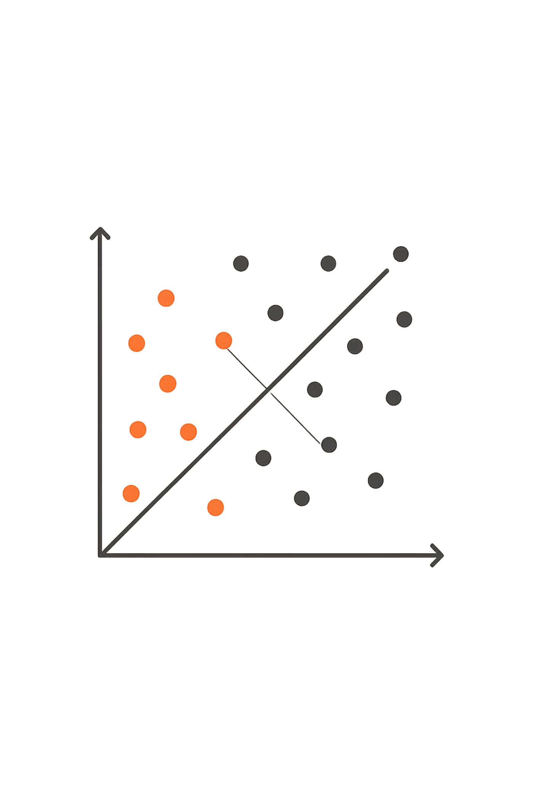
K-Nearest Neighbors (KNN) Algorithm
UNIT 3 · CLASSIFICATION & PREDICTION
JIYA CHAUDHARY
RA2311003030560
CSE CORE I

Slide 2
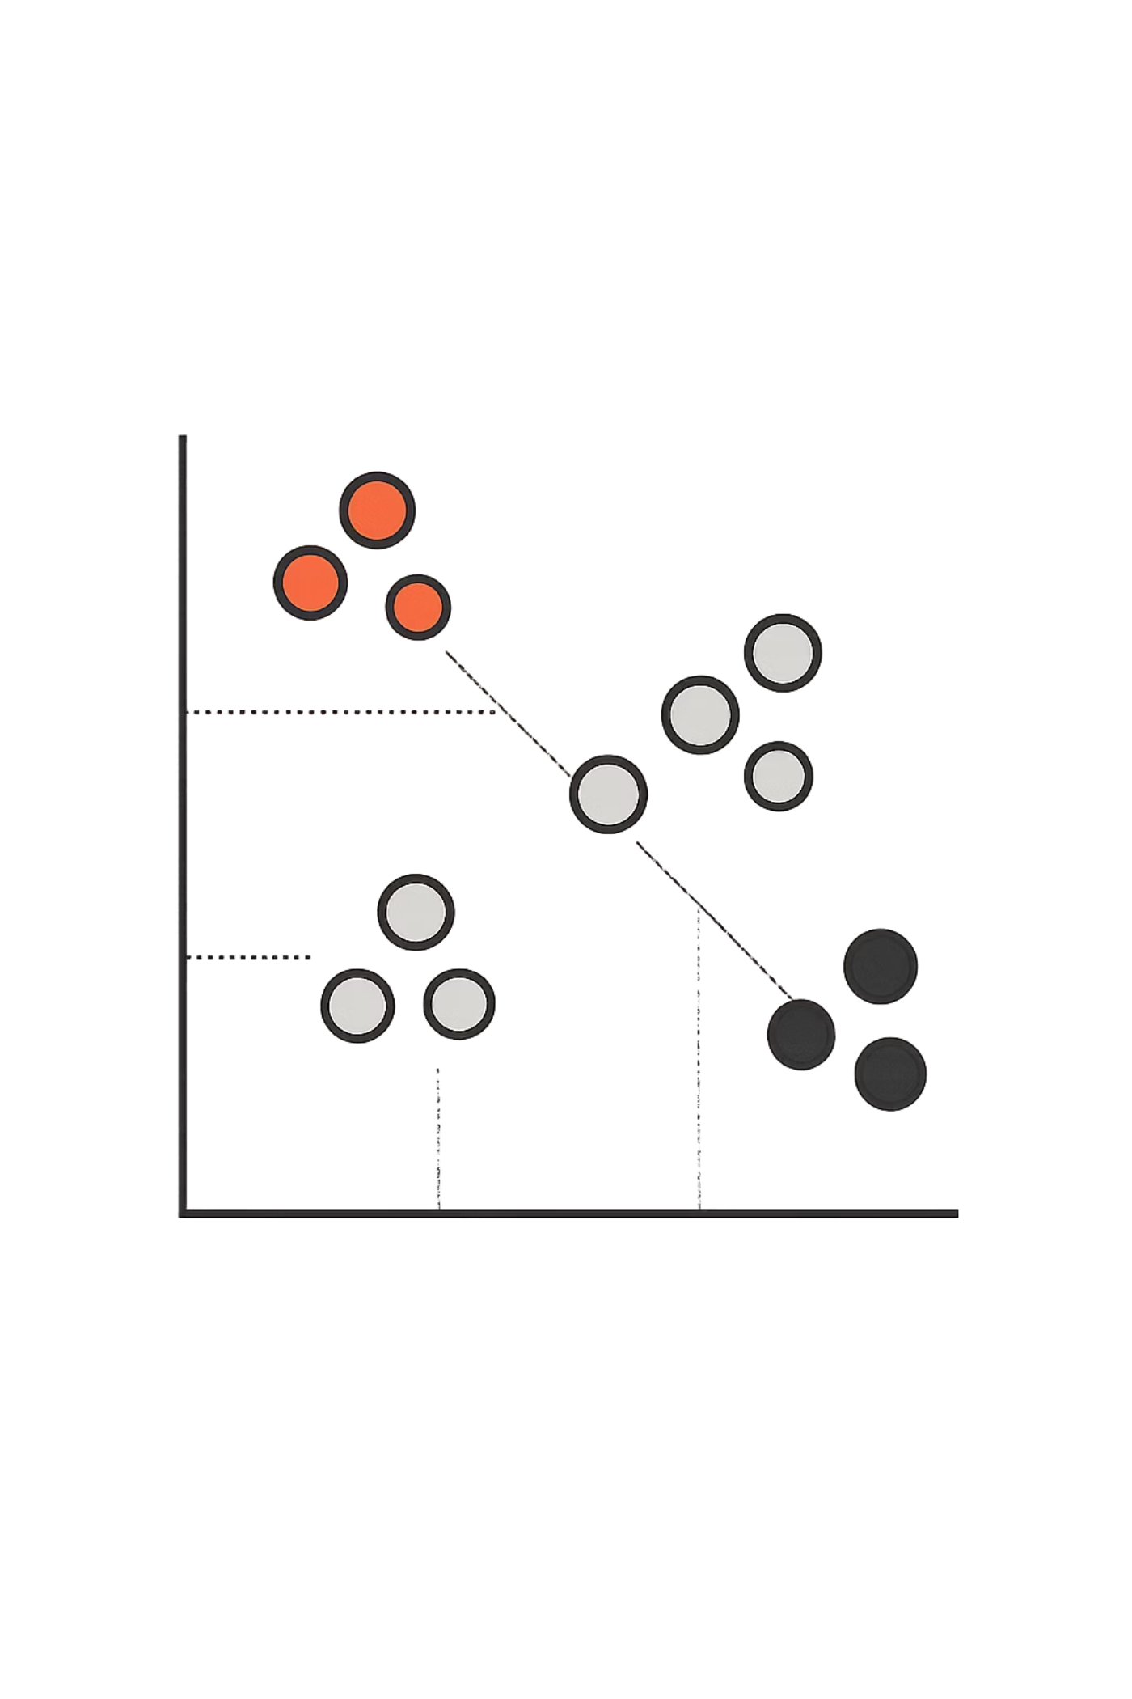

What is KNN?
KNN (K-Nearest Neighbors) is a supervised learning algorithm used for both classification and regression. It makes predictions based on similarity — the idea that data points close to each other in a feature space likely belong to the same class.
Core principle: KNN predicts the output by looking at the nearest known data points. "Nearby points decide the class."

Slide 3
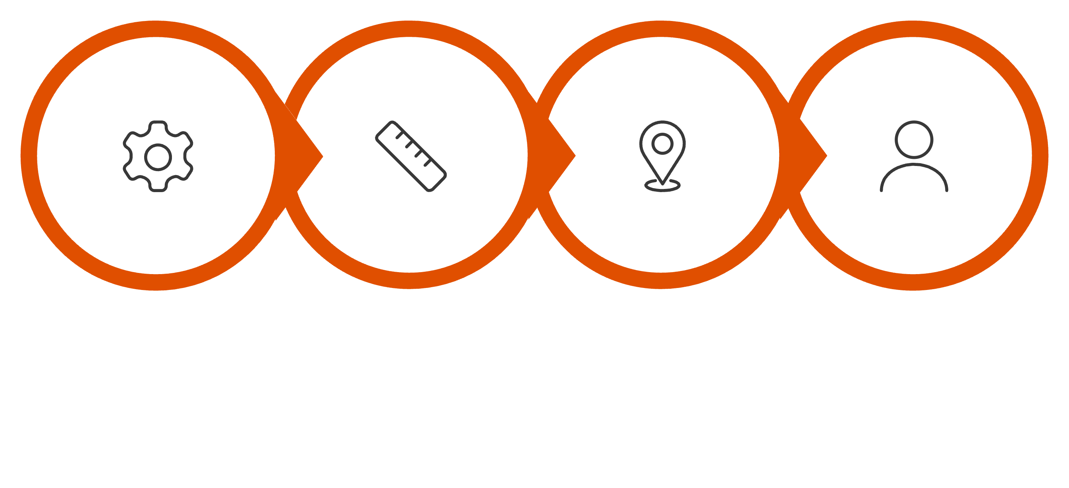
How KNN Works
KNN follows a simple, four-step process to classify a new data point.
Calculate Distances
Find K Nearest
Assign Majority
Choose K
The algorithm is lazy — it stores all training data and only computes when a new prediction is needed. No complex model is built in advance.

Slide 4
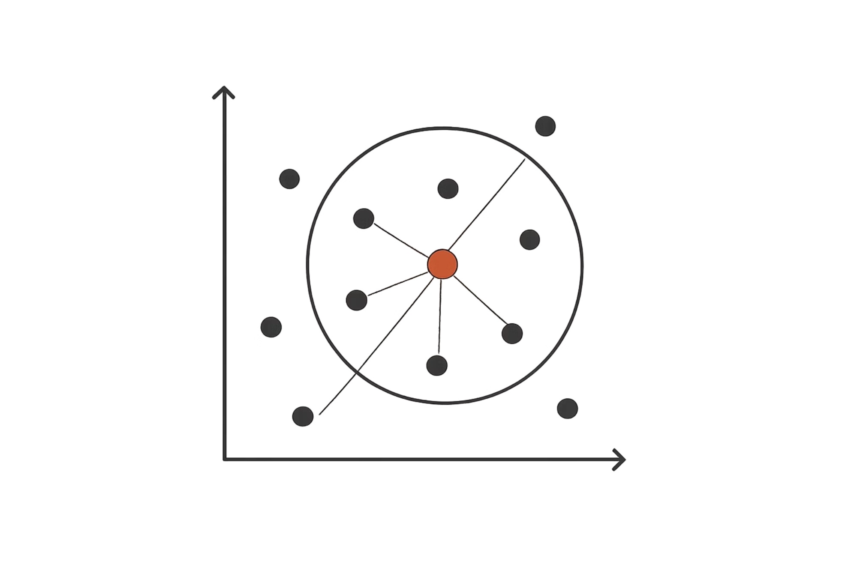
KNN in Action: A Worked Example
Suppose K = 3
A new point (★) needs to be classified. KNN finds the 3 nearest neighbors:
Result: 2 Red vs 1 Blue → ★ is classified as Red.
Neighbor 1
Neighbor 2
Neighbor 3
Red class
Red class
Blue class

Slide 5

Choosing the Right Value of K
The value of K is a hyperparameter you choose before running the algorithm. It directly affects how the model behaves.
K = 1
K = 3 or 5
K = Large
Very sensitive to noise. The single nearest point decides — can overfit.
A balanced choice. Smooths out noise while preserving local patterns.
Too smooth. May underfit by averaging over too many distant points.
Rule of thumb: Use an odd value for K in binary classification to avoid tied votes.

Slide 6
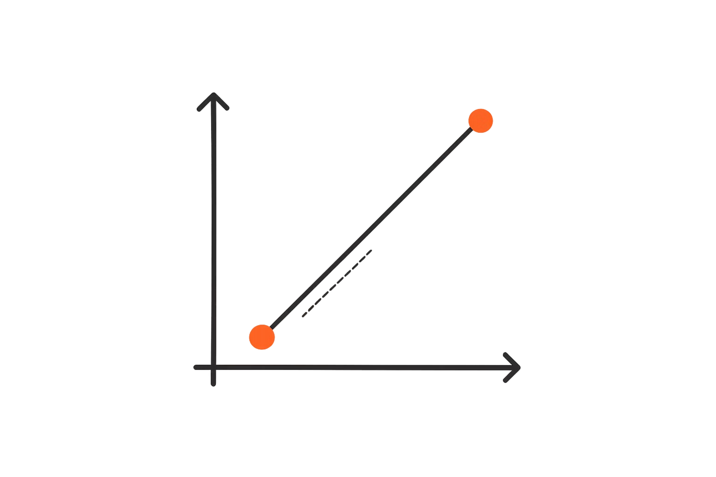
Measuring Distance: Euclidean Distance
KNN relies on distance to determine which points are "nearest." The most common metric is Euclidean Distance — the straight-line distance between two points in space.
Example: Point A (−6, −6) and Point B (6, 6) → d ≈ 16.97
Smaller distance = more similar. KNN ranks all points by this value and picks the K smallest.

Slide 7
Other Distance Metrics
Euclidean distance isn't the only option. Depending on your data, other metrics may work better.
Manhattan Distance
Euclidean Distance
Chebyshev Distance
Sums absolute differences. Useful in grid-like spaces (e.g., city blocks).
Straight-line distance. The default choice for most continuous data.
Takes the maximum difference along any dimension. Useful in chess or warehouse logistics.

Slide 8
Advantages & Disadvantages
✅ Simple & Intuitive
✅ No Training Phase
Easy to understand and implement — no complex mathematics required.
KNN is a lazy learner. It stores data and computes only at prediction time.
✅ Works Well on Small Data
⚠️ Slow on Large Data
Performs reliably when datasets are small and well-structured.
Computes distance to every point for each prediction — costly at scale.
⚠️ Sensitive to Noise
⚠️ Choosing K Matters
Outliers and irrelevant features can skew results significantly.
A poor K value leads to overfitting or underfitting.

Slide 9
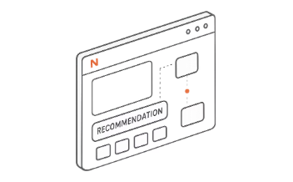
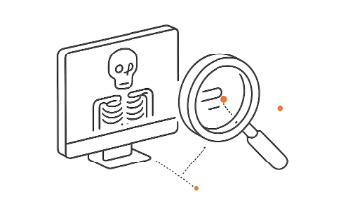


Real-World Applications of KNN
KNN is used across many industries thanks to its simplicity and effectiveness.
Recommendation Systems
Medical Diagnosis
Image Classification
Pattern Recognition
KNN helps classify patient data to assist in diagnosing conditions like diabetes or cancer.
Identifying objects in images by comparing pixel patterns to labeled examples.
Used in handwriting recognition, speech analysis, and biometric security systems.
Netflix and Amazon use KNN-like methods to suggest content based on similar user behavior.

Slide 10
Thank You & Questions

